Slide 1
Travel Demand Model Updates: NCDOT
November 15, 2023

Slide 2
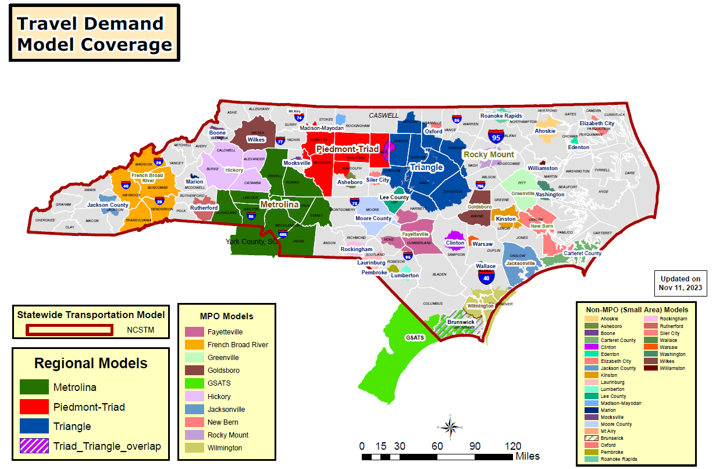

Slide 3
Current Model Updates
Completed:
Fayetteville (FAMPO)
Notes:
Hickory-Minor boundary changes and SE date. Base Year?

Slide 4
Current Model Updates
New Model :
Chatham County
Major Model Update :
Wilmington (WMPO)
Minor Model Update :
Greenville MPO
Goldsboro MPO
Moore County
French Broad River (FBRMPO)
Clinton Small Area Model
Notes:
Harnett County-BY is complete. No progress in the past 6 months.
Faeytville and Wilmington_ Boundary and SE data

Slide 5
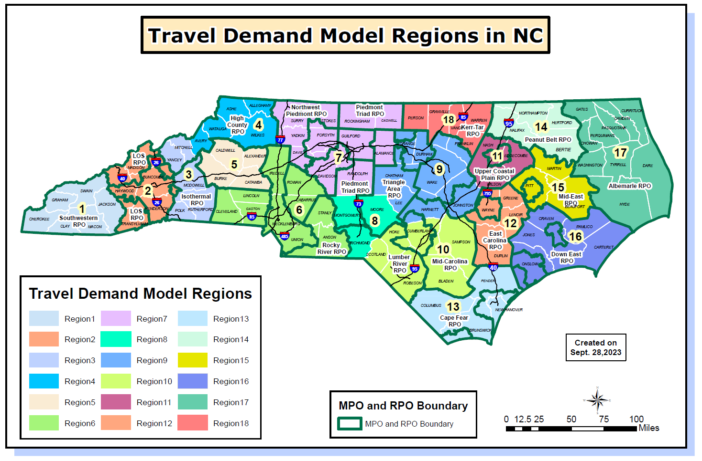
Notes:
Region 17: Completed by End of Summer
Region 1: “Fall”ish

Slide 6
Current Model Updates
Completed:
NCRTDM Region 17
Under Development:
NCRTDM Region 1
NCRTDM Region 16
NCRTDM Region 18
Notes:
Harnett County-BY is complete. No progress in the past 6 months.
Faeytville and Wilmington_ Boundary and SE data

